Slide 1
British airways Technology, DATA and insights
Cwen Fernandes

Slide 2
14.96% Successful/ COMPLETED BOOKING

Slide 3
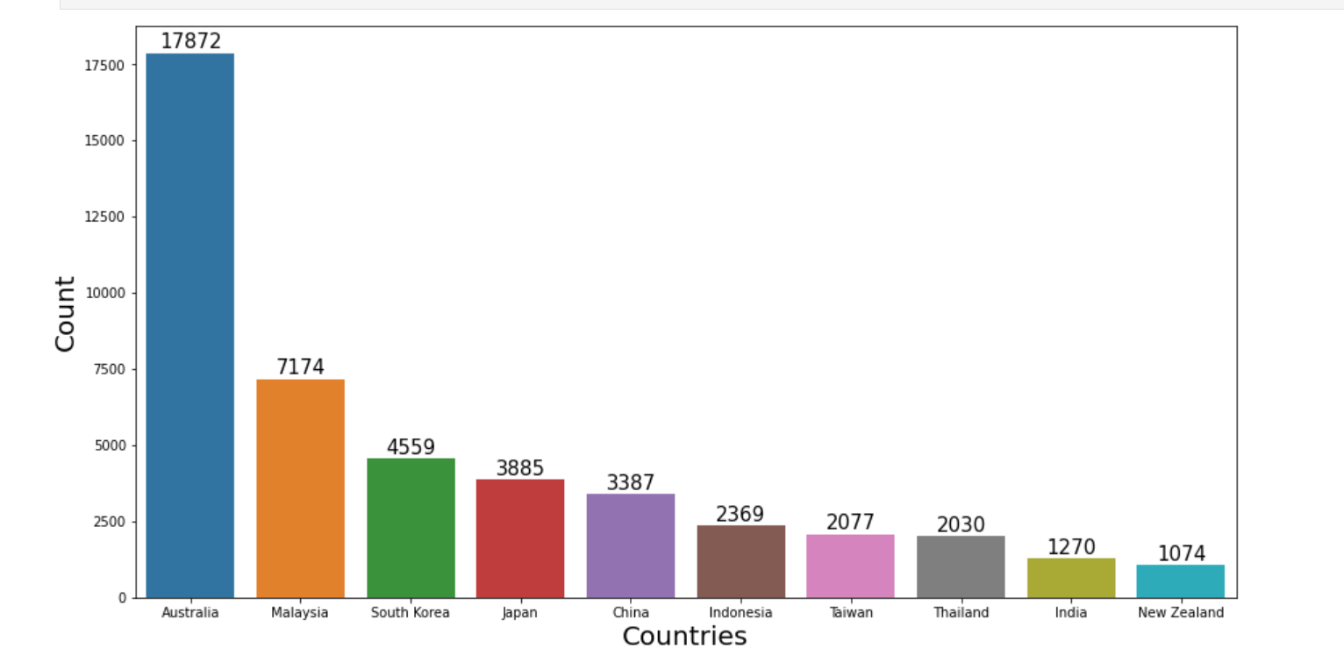
Top 10 countries with FLIGHT BOOKINGS

Slide 4
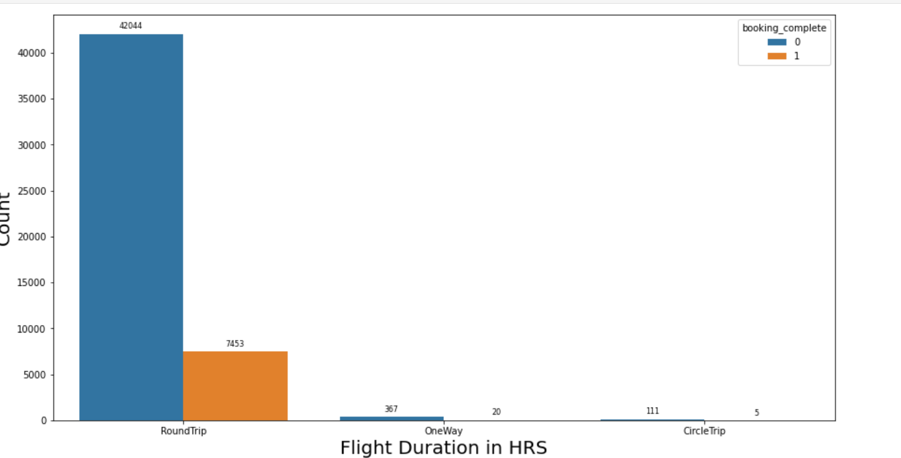
BOOKING WITH RESPECT TO FLIGHT DURATION

Slide 5
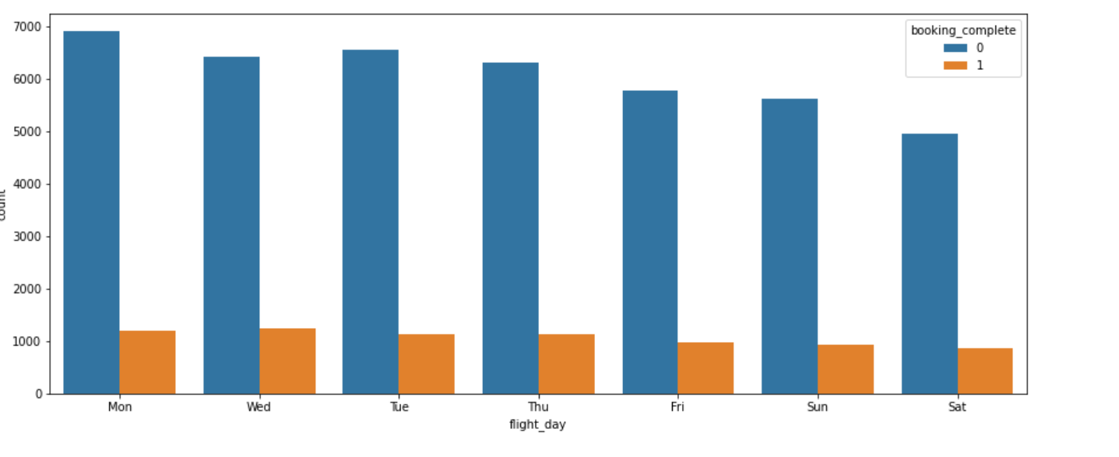
Booking based on day of the week

